Slide 1
ECE 313: PROBABILITY WITH ENGINEERING APPLICATIONS
Fall 2023
Prof. Eric Chitambar
Lecture 22

Slide 2


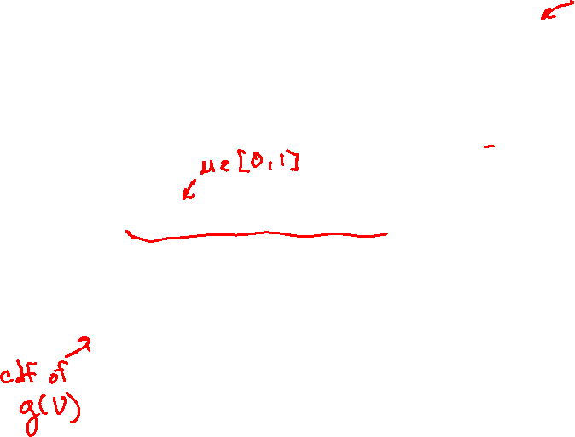
Generating a r.v. with a specified distribution

Slide 3
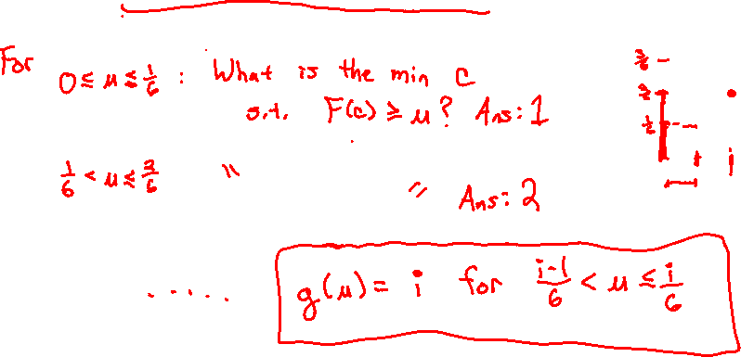
Generating a r.v. with a specified distribution

Slide 4


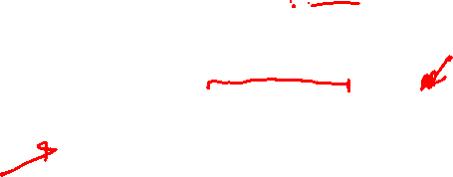
Failure Rate Functions

Slide 5



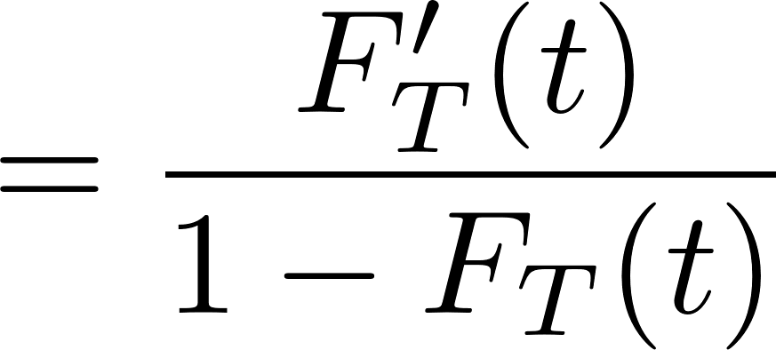
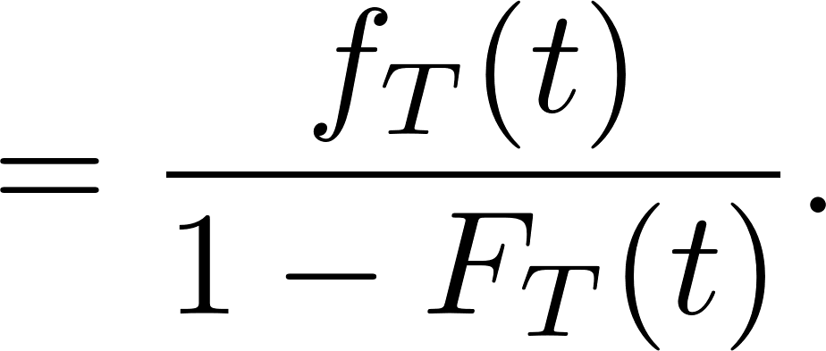

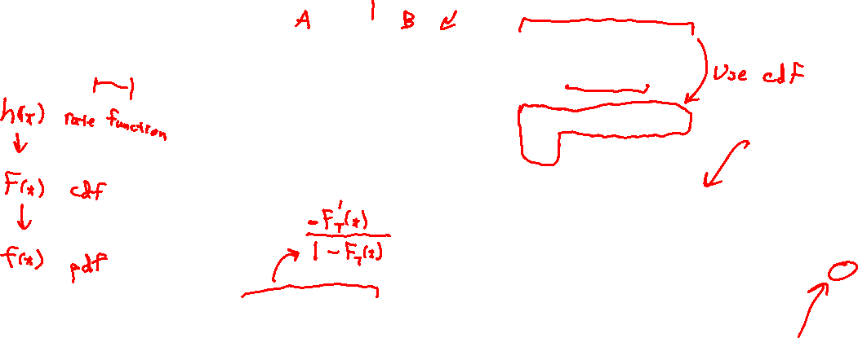
Failure Rate Functions

Slide 6

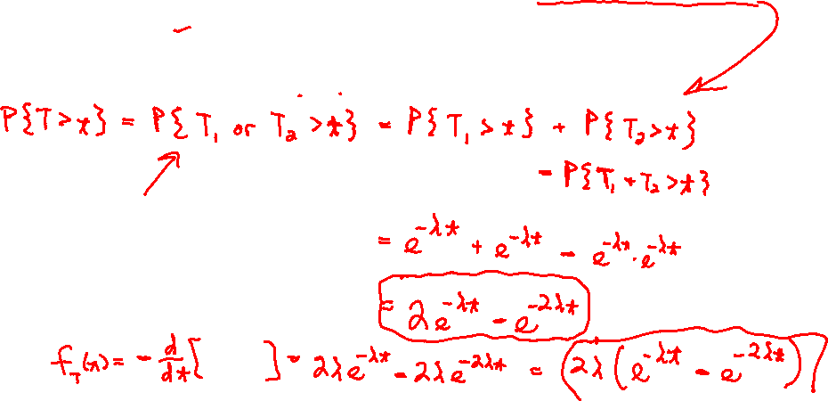
Failure Rate Functions

Slide 7

Failure Rate Functions

Slide 8
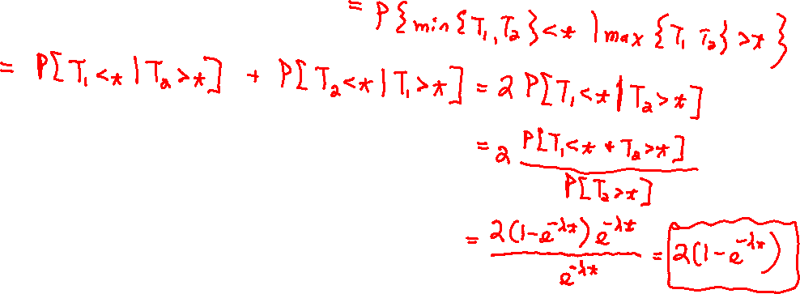
Failure Rate Functions

